Slide 1



Integrated Program in Business Analytics
Capstone Project on Zomato Data
IPBA Batch 11 Group: D

Slide 2

Agenda
Business Problem and Objectives
Executive Summary
Data Overview and Key Business Assumptions (if any)
Data Preparation and Pre-processing
Sanity checks, treatment and transformations for analytical dataset preparation
Exploratory Data Analysis
Key Business Findings and Insights
Model Development and Validations
Model comparisons on key scoring metrics and model finalization
Dashboarding (required only when it is in scope of analysis)
Business Recommendations and Potential Business Impact
Next Steps
Appendix

Slide 3

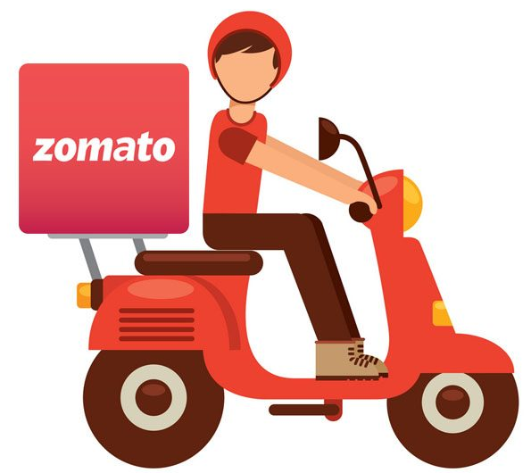
Business Problems and Objectives
Business Problem
Restaurant owners would like to gauge sentiments about their businesses from the reviews that they receive from different channels. This is a Sentiment Analysis project on the Zomato’s data on restaurants in Bangalore based on the text reviews written by Zomato users.
Objectives
Sentiment Analysis of restaurant reviews.
Exploratory Data analysis to find which restaurants are getting very good reviews in Bangalore.

Slide 4
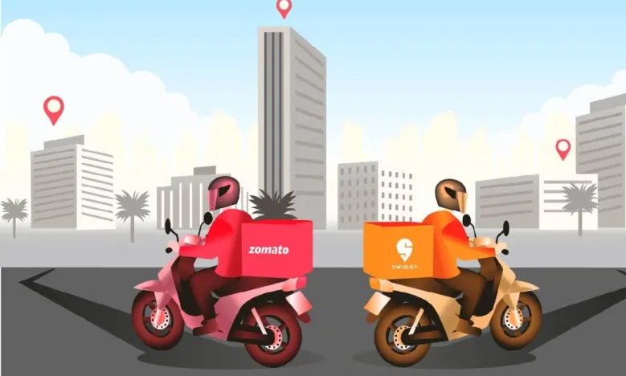
Executive Summary
Zomato Data on restaurants in Bangalore was picked up from Kaggle Dataset
The initial cleaning was done in CSV itself and then further cleaning was done using Python
We have then separated the EDA portion on 2 things, one on the average ratings provided by users and secondly the ratings we have used from the review
Our Sentiment analysis model was based on the reviews and rating accompanies those reviews.
We realised after cleaning the data and processing NLP steps that our data is imbalanced.
We used SMOTE method to balance the data
Models testes are Decision Tree Classifier and Random Forest Classifier.
Final model is Random Forest Classifier as it provided the better precision and recall values

Slide 5
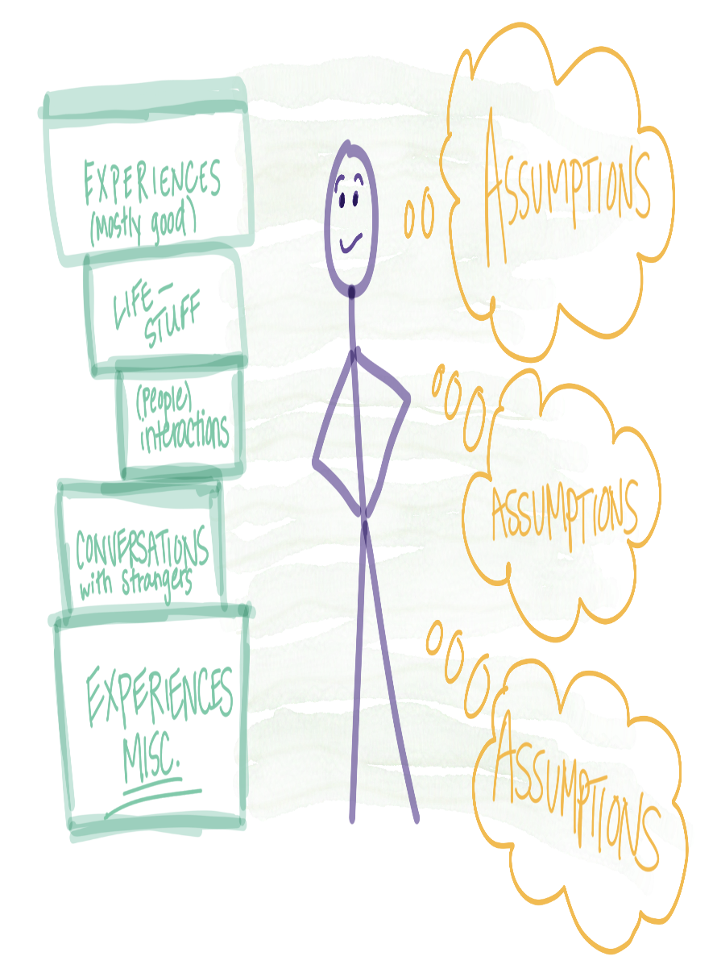
Data Overview and Key Business Assumptions
Zomato Data on restaurants in Bangalore was picked up from Kaggle Dataset
The Data consisted of
Names of restaurants
average rating on Zomato
number of votes, location
Cuisine type
Average cost for two
review text along with the rating where Zomato users have provided their review about the restaurant.
Two types of ratings in the data
Average rating of a restaurant
Text Review accompanied by Rating of that particular user who wrote the review and provided a rating along with the review.
The average ratings and rating came with review posed an interesting challenge because average rating is based on multiple peoples ratings which includes the ratings coming from people who wrote reviews as well.
After discussing with mentor, we decided to use the rating that came with the verbose text review to ultimately confirm if the sentiments expressed in the review are matching with the rating provided by the same individual
So for EDA to find out good restaurants in Bangalore, we used the average ratings available in the data

Slide 6
Data Preparation and Pre-processing

Slide 7


Data Cleaning Process – Excel
Excel
Python
The initial Data was in Excel which was more than half a GB CSV file
We did cleaning in CSV file first deleting a few unnecessary columns and some wrongly set up rows which were deleted
Further data cleaning was done using python
Sl.No. | Data | Number of Records | Cleaning Method
1 | Zomato Data | 56079 | Excel
2 | Zomato Usable Data | 19268 | Excel
3 | Output | 19147 | Final from Excel
Sl.No | Data | Number of Records | Cleaning Method
3 | Zomato Capstone Data | 19147 | CSV
4 | Duplicate Reviews | 10995 | Python
5 | Cleaning the Review Column and Removing Duplicate Reviews | 9128 | Python

Slide 8
Exploratory Data Analysis

Slide 9
High Level Findings
Total restaurant entries in the available data are 19147
The number of unique restaurants (Including restaurant Chains) is 4299
Total number Unique restaurant names (Chain is counted as one single Entity) are 2986
Average Rating for all restaurants in Bangalore is around 3.85
There are 87 main locations (localities in Bangalore) as per the data
Average cost for two persons is around 650 INR in Bangalore across locations

Slide 10
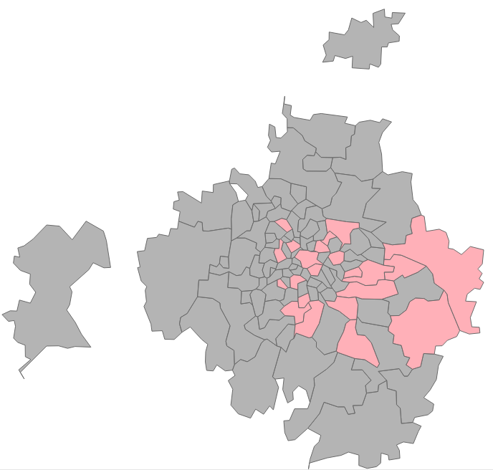
Bangalore Focus Area

Slide 11
Bangalore – Data Insight
Bangalore is the IT Capital of INDIA.
We are having more than moving population in Bangalore, highest among all major cities in India.
We have 111 Pin Codes across 260 Locations
We have data covering 22 Pin codes across 87 Locations
Which is around 20% of Pin codes with 30% of the area.
But population wise this covers upto 80% of the Population

Slide 12
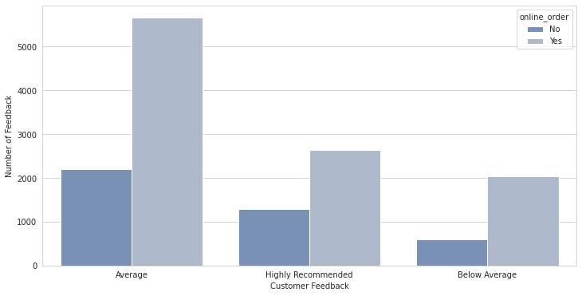
Number of Feedback v/s the Rating
Number of Reviews

Slide 13
Online Order v/s Rate Grouped
online_order v/s rate_cat | No | Yes
Average | 2201 | 5659
Below Average | 595 | 2034
Highly Recommended | 1284 | 2639
online_order v/s rate_cat | No | Yes
Average | 28.00 | 72.00
Below Average | 22.63 | 77.37
Highly Recommended | 32.73 | 67.27

Slide 14
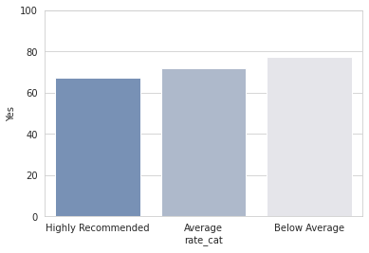
Online Order v/s the Rating

Slide 15
Best Budget Restaurant based on number of Resturant_type
Resturant type :Buffet name Southindies 4.285 Name: ExtractedRate, dtype: float64
Resturant type :Cafes name The Hungry Shark Cafe 5.0 Name: ExtractedRate, dtype: float64
Resturant type :Delivery name Hyderabad Biryaani Palace 5.0 Name: ExtractedRate, dtype: float64
Resturant type :Desserts name The Hungry Shark Cafe 5.0 Name: ExtractedRate, dtype: float64
Resturant type :Dine-out name SR Andhra Spicy House 5.0 Name: ExtractedRate, dtype: float64
Resturant type :Drinks & nightlife name Baar Union 4.56 Name: ExtractedRate, dtype: float64
Resturant type :Pubs and bars name Baar Union 4.55 Name: ExtractedRate, dtype: float64

Slide 16
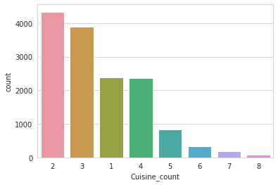
Type of Cusines v/s Number of Reviews

Slide 17
Best Budget Resturant based on number of Cuisine
Cuisines :1 name SR Andhra Spicy House 5.0 Name: ExtractedRate, dtype: float64
Cuisines :2 name BIB - Breakfast in the Box 5.0 Name: ExtractedRate, dtype: float64
Cuisines :3 name The Hungry Shark Cafe 5.0 Name: ExtractedRate, dtype: float64
Cuisines :4 name Kuttanadu 5.0 Name: ExtractedRate, dtype: float64
Cuisines :5 name Navrang Kabab Korner 5.0 Name: ExtractedRate, dtype: float64
Cuisines :6 name Bamey's Restro Cafe 4.374 Name: ExtractedRate, dtype: float64
Cuisines :7 name Coffee Mechanics 4.38 Name: ExtractedRate, dtype: float64
Cuisines :8 name The Nosh House 4.26 Name: ExtractedRate, dtype: float64

Slide 18
EDA on Restaurants
Total Number of Unique restaurants in Bangalore is 2986
If the branches of restaurant chains are included as separate restaurant the count goes up to 4299
Number of restaurants with Just one outlet is 2523 which a very high 84%
Domino’s Pizza (26), KFC (24), Pizza Hut (24), Fasoos (22) and McDonald’s (22) are the top 5 restaurant chains in Bangalore
The highest rated restaurant chain in Bangalore is Belgian Waffle Factory with an average rating of 4.85
The highest rated Single outlet restaurant in Bangalore is Byg Brewski Brewing Company with a rating of 4.9

Slide 19
EDA on Restaurants Names
Horizontal red line is an average rating line
The top 3 alphabets are T, S and C with 334, 320 and 269 unique names starting with them
The bottom 3 alphabets are Q, X and Y with 5, 6 and 13 unique names starting with them
Q and X also have an average rating above 4 but that is due to extremely small sample size. Otherwise T tops again with an average rating of 3.91
Alphabets N and U have the lowest average rating of 3.68.
All other alphabets hover around the mean rating

Slide 20
EDA Online Orders & Table Booking
The number of restaurants accepting online orders is 2942 which is 68%
The number of restaurants accepting table booking is low which is 3478 and that is almost 81%
There is not much difference between ratings of either type of restaurants. Accepting ones are at 3.82 and non accepting ones are at 3.88
There is a lot of difference between ratings of either type of restaurants. The ones that accept have average rating of 4.11 against the ones that those accept are at 3.77

Slide 21
EDA Online Orders & Table Booking
The above graph clearly shows that online ordering has no significant impact on ratings but Table booking has
So when table booking is accepted the rating improves even if the restaurant doesn’t offer online ordering

Slide 22
EDA Online Orders & Table Booking
The above graph clearly shows that online ordering has no significant impact on ratings but Table booking has
So when table booking is accepted the rating improves even if the restaurant doesn’t offer online ordering

Slide 23
EDA on Ratings
Rating Categories | No of Restaurants | Rating
Not Recommended | 266 | 2.70
Below Average | 321 | 3.20
Average | 2830 | 3.88
Recommended | 695 | 4.27
Highly Recommended | 159 | 4.57
66% of the restaurants fall in the average rating which are 2830 with an average rating of 3.88
14% are below the mean and 20% are above. Only 4% restaurants are in highly recommended category

Slide 24
Where are highly recommended restaurants located?
Lavelle Road has highest % of highly recommended restaurants which is 61%. The cut off for the location is considered as min 20 restaurants in the location.
Indira Nagar has 70 highly recommended restaurants and that makes it the top location from the count perspective

Slide 25
Where are highly recommended restaurants located?
Indira Nagar has highest number of restaurants in Bangalore

Slide 26
EDA of average cost for 2 people
Average cost for 2 people across Bangalore is 650 INR. Accordingly the categories are made in the above table
When the cost goes above 1200 INR, the ratings are highest at 4.15
Ratings gradually decline as the cost falls further but the budget restaurants have better ratings than the average cost restaurants
Restaurant Type | Rating | No of Restaurants | Cost Range
Premium | 4.15 | 139 | 2000+
Expensive | 4.15 | 420 | 1200 - 2000
Above Average | 3.94 | 334 | 800-1200
Average | 3.78 | 1699 | 500-800
Budget | 3.96 | 133 | 200-500
Pocket Friendly | 3.77 | 1574 | Less than 200

Slide 27
Locations with Highest Ratings
Location | Rating | No of Restaurants
Lavelle Road | 4.12 | 44
Koramangala 5th Block | 4.11 | 170
Seshadripuram | 4.08 | 23
Residency Road | 4.05 | 48
St. Marks Road | 4.05 | 28
Richmond Road | 4.03 | 36
Church Street | 4.01 | 43
Ulsoor | 4.00 | 45
Koramangala 4th Block | 3.98 | 72
Cunningham Road | 3.95 | 26

Slide 28
Locations with Lowest Ratings
Location | Rating | No of Restaurants
Kaggadasapura | 3.59 | 24
Kumaraswamy Layout | 3.61 | 22
Domlur | 3.64 | 34
Bannerghatta Road | 3.66 | 122
Banaswadi | 3.67 | 55
Bellandur | 3.67 | 103
Brookefield | 3.68 | 71
Electronic City | 3.69 | 148
Jeevan Bhima Nagar | 3.69 | 44
Nagawara | 3.71 | 35

Slide 29
Top 10 Restaurant Types in Bangalore
Highest are multi Cuisine and that is intuitive as well. Others mainly covers cafes, beverages shops and some street food outlets
Type of Cuisine | Rating | No Of Restaurants
Multi Cuisine | 3.76 | 1741
Others | 3.94 | 948
North Indian | 3.77 | 285
Continental | 3.99 | 283
Indian Regional | 3.84 | 267
Asian | 3.90 | 250
South Indian | 3.90 | 203
Italian | 3.74 | 148
Bakery | 3.91 | 124
Midde Eastern | 3.98 | 50

Slide 30
Highest Rated Restaurant Types in Bangalore
While Multi Cuisine restaurants are highest, their ratings are below average
Type of Cuisine | Rating | No Of Restaurants
Continental | 3.99 | 283
Midde Eastern | 3.98 | 50
Others | 3.94 | 948
Bakery | 3.91 | 124
South Indian | 3.90 | 203
Asian | 3.90 | 250
Indian Regional | 3.84 | 267
North Indian | 3.77 | 285
Multi Cuisine | 3.76 | 1741
Italian | 3.74 | 148

Slide 31
Locations with Lowest Ratings
Location | Rating | No of Restaurants
Kaggadasapura | 3.59 | 24
Kumaraswamy Layout | 3.61 | 22
Domlur | 3.64 | 34
Bannerghatta Road | 3.66 | 122
Banaswadi | 3.67 | 55
Bellandur | 3.67 | 103
Brookefield | 3.68 | 71
Electronic City | 3.69 | 148
Jeevan Bhima Nagar | 3.69 | 44
Nagawara | 3.71 | 35

Slide 32
Top Asian Restaurants in Bangalore
Location | Rating
Asia Kitchen By Mainland China | 4.9
Rim Naam - The Oberoi | 4.6
The Fatty Bao - Asian Gastro Bar | 4.6
MISU | 4.6
HOMMS | 4.5
Republic Of Noodles - Lemon Tree Premier | 4.5
OKI | 4.5
ASEAN - On The Edge | 4.5
Big Wong XL | 4.5
Mainland China | 4.4

Slide 33
Top Bakeries in Bangalore
Location | Rating
O.G. Variar & Sons | 4.8
Mugful Of Stories | 4.6
Le Gateau - The Cake Shop | 4.4
Occasions | 4.3
Soul Treat | 4.3
The Sugar Fairy | 4.3
Albert Bakery | 4.3
Dream a Dozen | 4.3
Cakewala | 4.2
Patisserie Nitash | 4.2

Slide 34
Top Continental Restaurants in Bangalore
Location | Rating
Toit | 4.7
Communiti | 4.7
The Boozy Griffin | 4.6
Chili's American Grill & Bar | 4.6
Toast & Tonic | 4.6
Caperberry | 4.6
Smoke House Deli | 4.6
Lot Like Crepes | 4.6
Galito's | 4.6
Bloomsbury's Global Kitchen & Bakehouse | 4.5

Slide 35
Top Indian regional Food Restaurants in Bangalore
Location | Rating
Maziga | 4.7
Sly Granny - The Community House | 4.5
Karavalli - The Gateway Hotel | 4.5
RockSalt | 4.4
Bombay Adda | 4.4
Siddiqu Kabab Center | 4.4
The Konkan - Seafood Restaurant | 4.4
Kanua | 4.4
Maravanthe | 4.4
XOOX Brewmill | 4.4

Slide 36
Top Italian Restaurants in Bangalore
Location | Rating
Chianti | 4.6
Pasta Street | 4.5
Alba - JW Marriott Bengaluru | 4.5
Toscano | 4.4
Ottimo - ITC Gardenia | 4.3
Alto Vino - Bengaluru Marriott Hotel Whitefield | 4.3
Little Italy | 4.3
Mojo Pizza - 2X Toppings | 4.2
Via Milano | 4.2
Caprese - Shangri-La Hotel | 4.2

Slide 37
Top Middle Eastern Restaurants in Bangalore
Location | Rating
Bonum cibum | 4.5
Olive Bar And Kitchen | 4.5
Fenny's Lounge And Kitchen | 4.5
Salvadores | 4.4
Fava Bistro | 4.4
The Marash | 4.3
Capri Gastrobar | 4.3
Habibi Falafel | 4.3
The Persian Terrace - Sheraton Grand Bangalore Hotel... | 4.2
Byblos | 4.2

Slide 38
Top Multi-Cuisine Restaurants in Bangalore
Location | Rating
Byg Brewski Brewing Company | 4.9
Biergarten | 4.8
The Black Pearl | 4.8
AB's - Absolute Barbecues | 4.7
The Big Barbeque | 4.7
TBC Sky Lounge | 4.7
ECHOES Koramangala | 4.7
House Of Commons | 4.7
Flechazo | 4.7
Big Pitcher | 4.7

Slide 39
Top North Indian Restaurants in Bangalore
Location | Rating
Punjab Grill | 4.8
Mumbai Tiffin | 4.4
Ssaffron - Shangri-La Hotel | 4.4
Mooch Marod | 4.4
Le Arabia | 4.3
Arya Hungry? | 4.3
Qissa Khawani | 4.3
Barbecued - By The Orchard | 4.3
Dum Pukht Jolly Nabobs - ITC Windsor | 4.3
Royal Afghan - ITC Windsor | 4.3

Slide 40
Top Other (Cafes etc) Restaurants in Bangalore
Location | Rating
Belgian Waffle Factory | 4.9
The Blue Wagon - Kitchen | 4.6
The Pancake Story | 4.6
The Hole in the Wall Cafe | 4.6
Kurtoskalacs | 4.6
Truffles | 4.6
Via Milano | 4.6
Dock Frost'd | 4.6
Milano Ice Cream | 4.5
Shakes Theory | 4.5

Slide 41
Top South Indian Restaurants in Bangalore
Location | Rating
Taaza Thindi | 4.7
Oota Bangalore | 4.6
The Permit Room | 4.5
Bengaluru Cafe | 4.5
HVR Veg | 4.5
Sri Laxmi Venkateshwara Coffee Bar | 4.4
Malleshwaram Dosa Corner | 4.4
Chikkanna Tiffin Room | 4.4
Gods Own Cafe | 4.4
Raghavendra Tiffin | 4.4

Slide 42
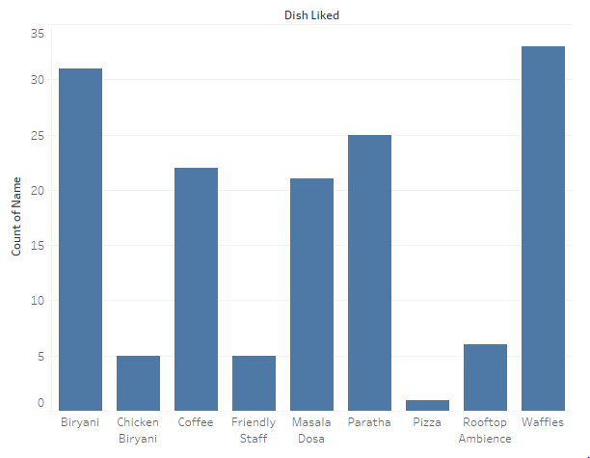
DISH LIKED

Slide 43
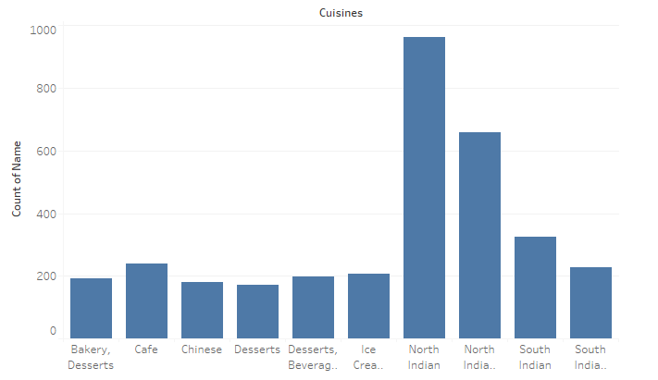
CUISINES

Slide 44
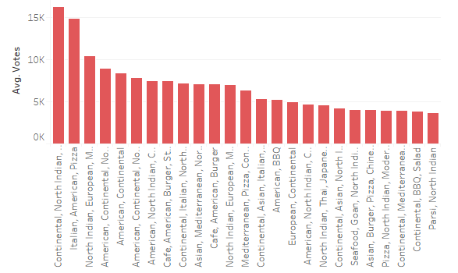
Top 25 Popular Cusinies of Bangalore Restaurants by Votes

Slide 45
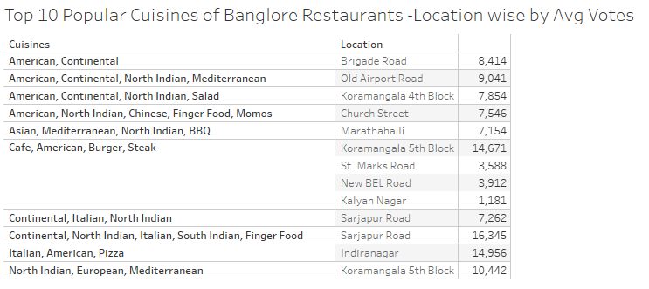
Top 10 Popular Cuisines of Bangalore – Locationwise by Avg Votes

Slide 46
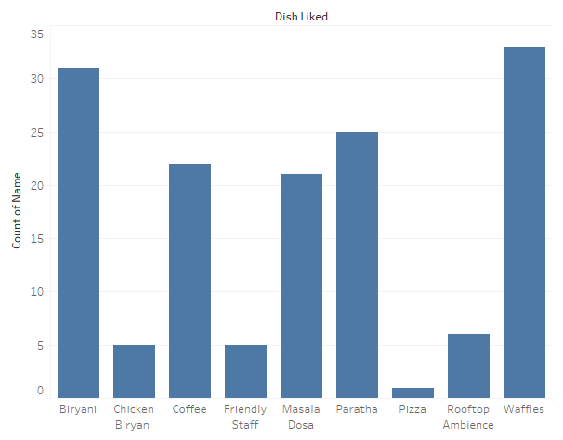
Dish Liked

Slide 47
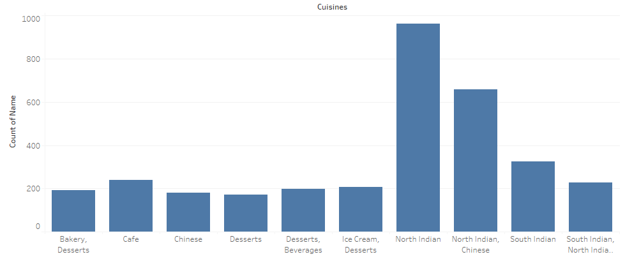
Cuisines

Slide 48
Model Development and Validations

Slide 49
Analysis of Rate and derived New Method
6 | Rate Analysis from Rate Column
 | Average Highly Recommended Below Average | 5397 3677 76
6 | Rate Analysis from Review Text – Average Rate
 | Average Highly Recommended Below Average | 4891 2770 1467
In Both Method the Data was imbalanced

Slide 50
Because Data was imbalanced
We were to use the SMOTE system to convert imbalanced Data to Balanced Data
By this the Rate Calculator the Highest Number gets allocated to all Buckets
6 | Rate Calculator From Review Text
 | Average Highly Recommended Below Average | 4891 2770 1467 | 4891 4891 4891
 | Number of Records |  | 14673

Slide 51
Split the Data into Train & Test Data
From sklearn model imported train_test_split program
By this the data got split accordingly
Type | Number of Records | %
Train | 9830 | 67
Test | 4843 | 33
Total | 14963 | 100

Slide 52
Model Tested are
Decision Tree Classifier
Random forest Classifier

Slide 53
Decision Tree Classifier
DecisionTreeClassification Report
 | precision | recall | f1-score | support
Average | 0.69 | 0.62 | 0.65 | 1668
Below Average | 0.72 | 0.83 | 077 | 1583
Highly Recommended | 0.72 | 0.68 | 0.70 | 1592
Accuracy |  |  | 0.71 | 4843
macro avg | 0.71 | 0.71 | 0.71 | 4843
weighted avg | 0.71 | 0.71 | 0.71 | 4843
The project accuracy is Decision Tree Classifier 71.0 %

Slide 54
RandomForestClassifier
RandomForestClassification Report
 | precision | recall | f1-score | support
Average | 0.82 | 0.76 | 0.79 | 1,002
Below Average | 0.80 | 0.91 | 0.85 | 976
Highly Recommended | 0.86 | 0.80 | 0.83 | 957
accuracy |  |  | 0.83 | 2,935
macro avg | 0.83 | 0.83 | 0.83 | 2,935
weighted avg | 0.83 | 0.83 | 0.82 | 2,935
The project accuracy is RandomForestClassifier 81.0 %

Slide 55
We are just getting started..
Try new models and Increase the accuracy of the existing models
Extract data directly from Zomato
Test with live data
Build dashboards for the EDA analysis in tableau

Slide 56

THANK YOU!

Slide 57
SMOTE for Machine Learning
Synthetic Minority Oversampling Technique
Imbalanced data is data in which observed frequencies are very different across the different possible values of a categorical variable. Basically, there are many observations of some type and very few of another type.
SMOTE algorithm as a solution for imbalanced data in classification problems. SMOTE is an intelligent alternative to oversampling: rather than creating duplicates of the minority class, it creates synthetic data points that are relatively similar to the original ones.
Using SMOTE, your model will start detecting more cases of the minority class, which will result in an increased recall, but a decreased precision

